Slide 1
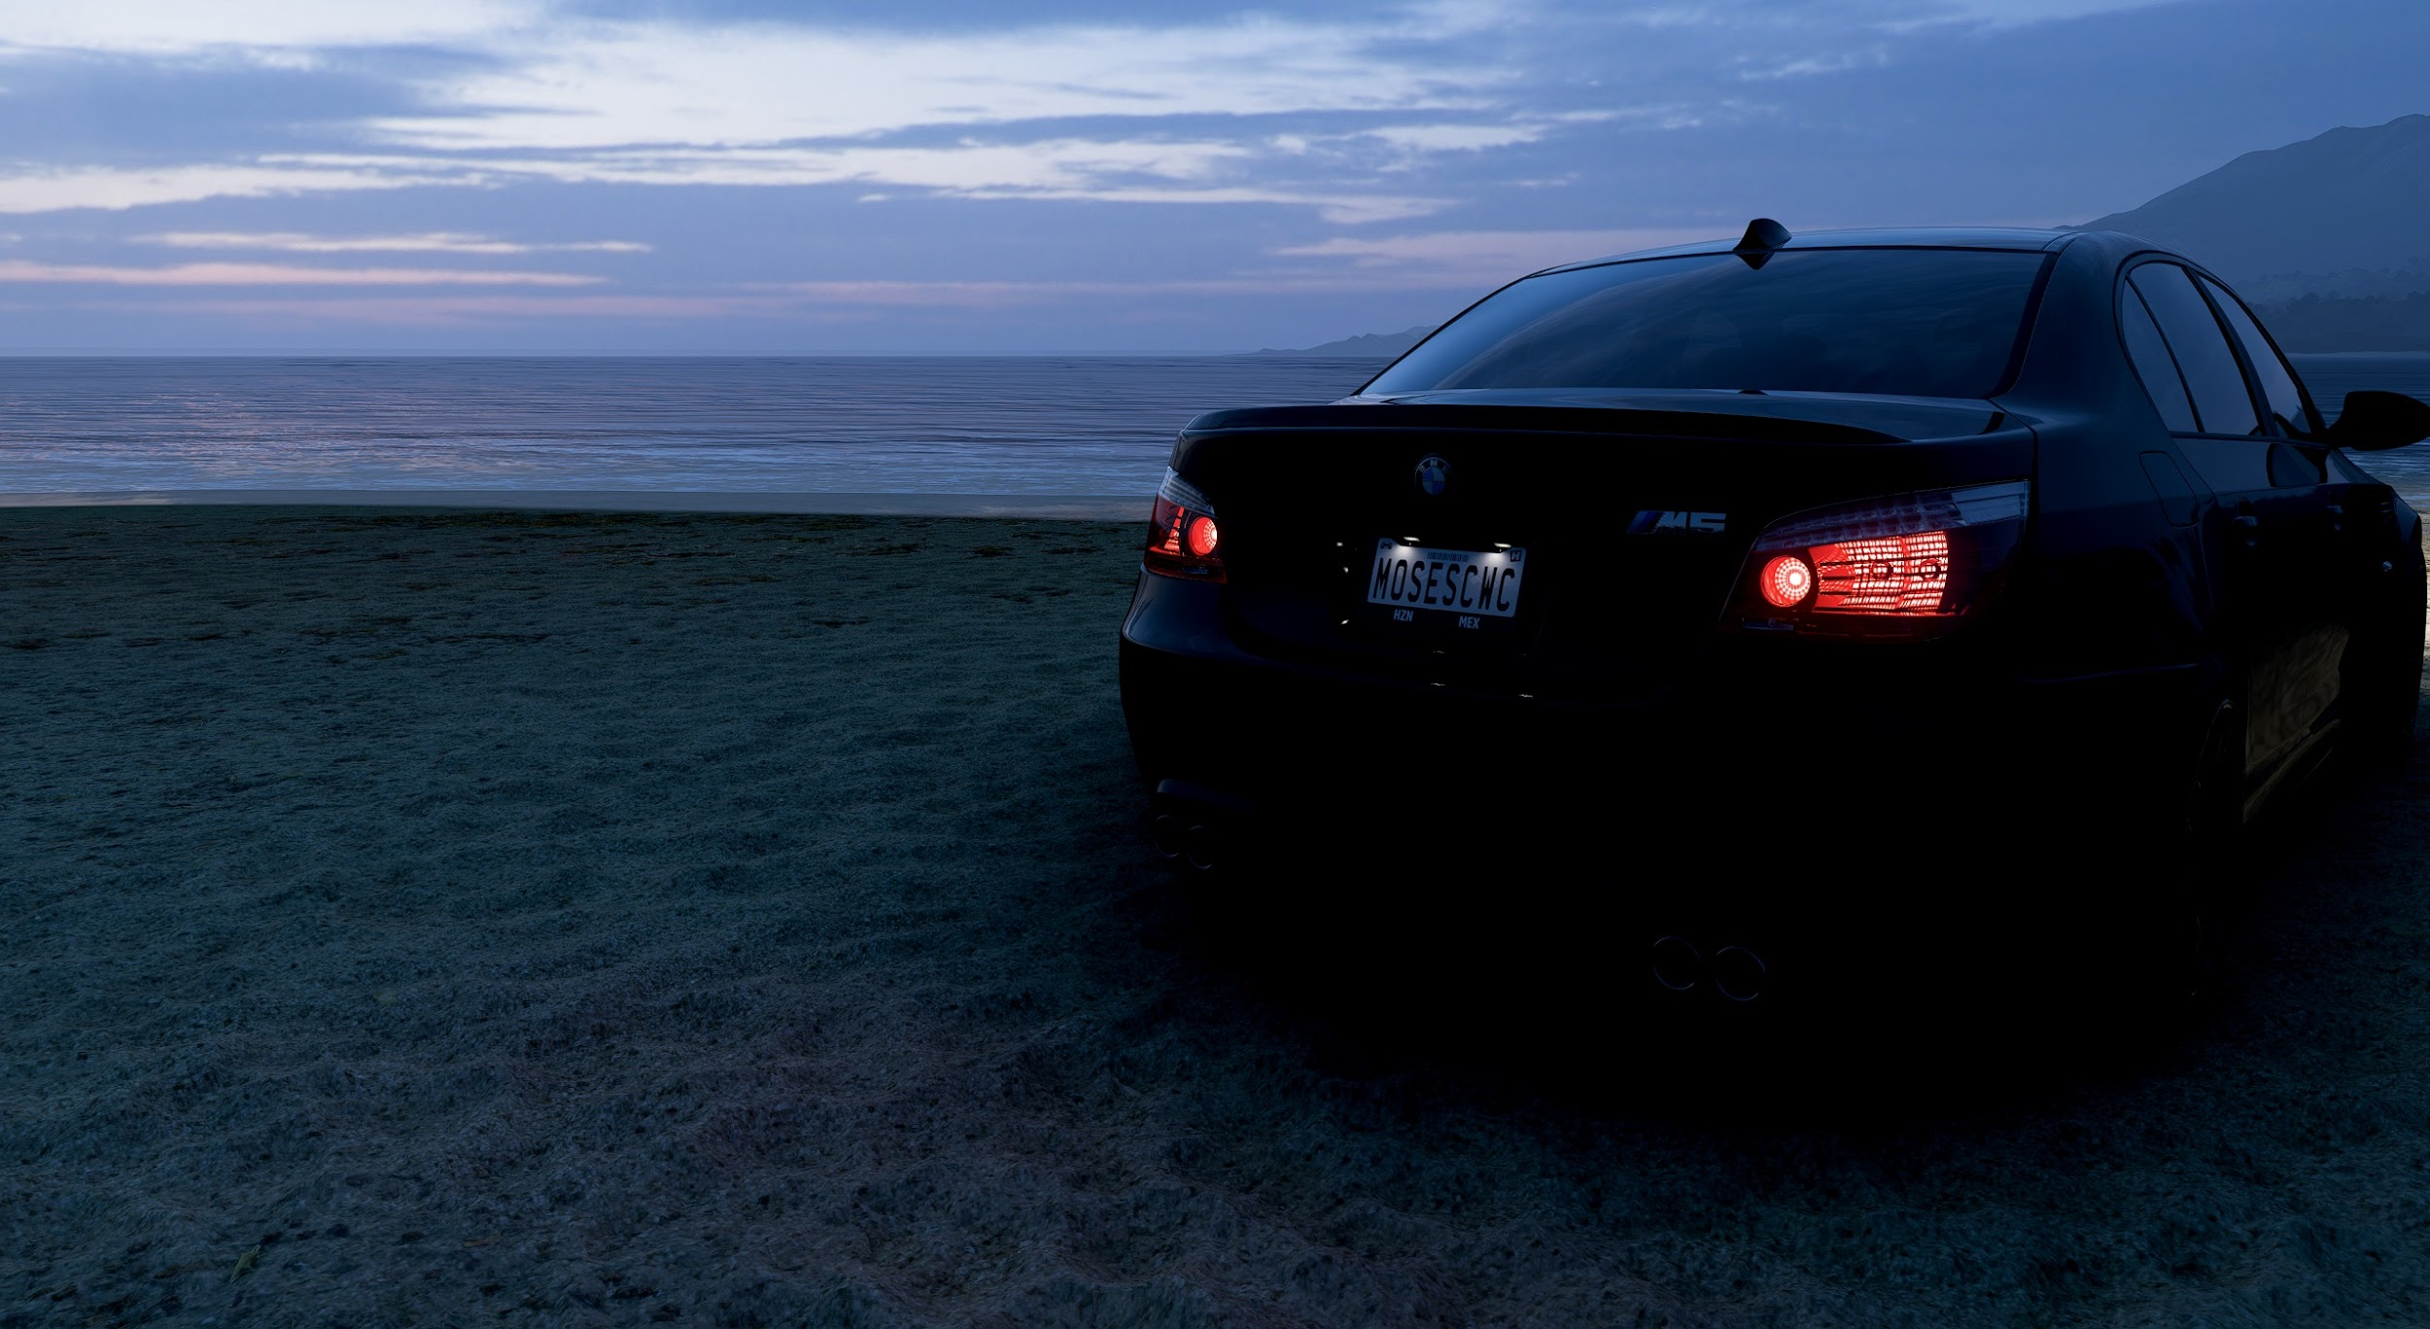
Optimizing My Performance
Brian Moses
STEP 2026 Participant
Digital Technology Support Specialist 4 years at Synchrony
“ One day you’ll leave this world behind, so live a life you will remember.” - Avicii

Slide 2
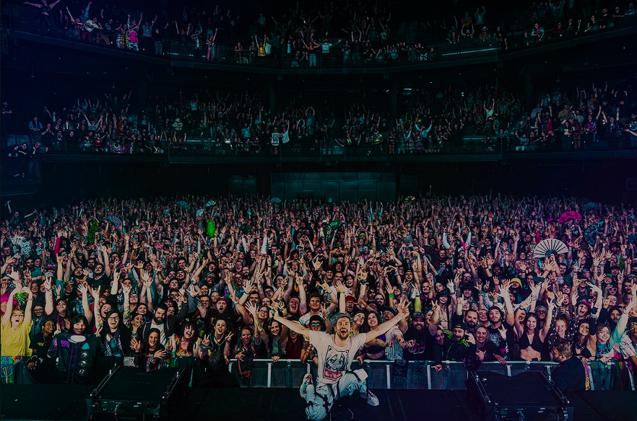
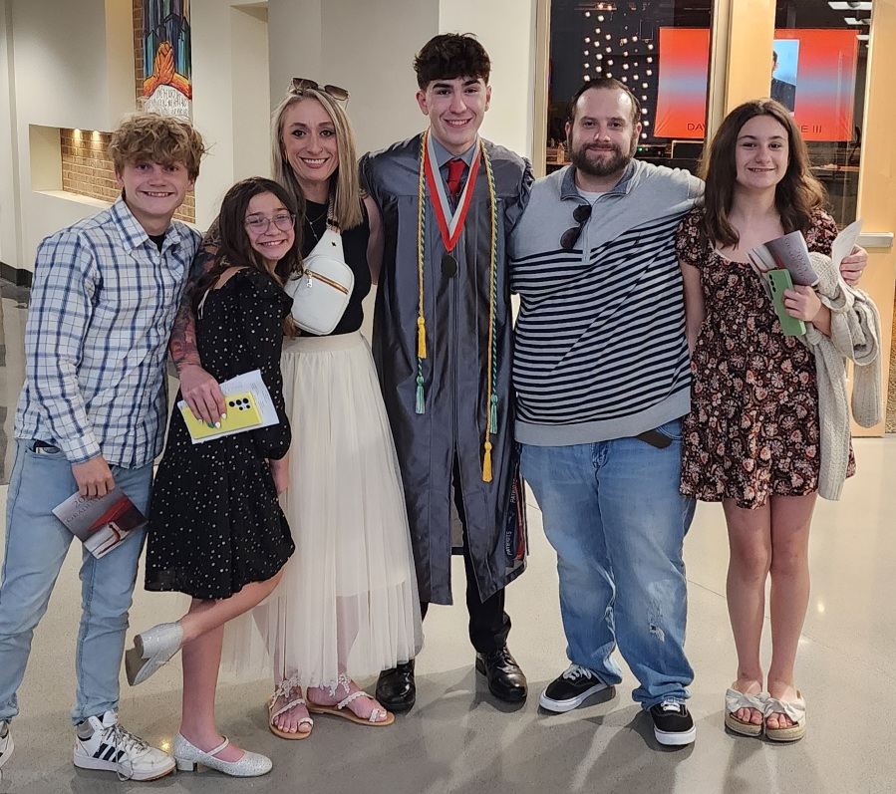
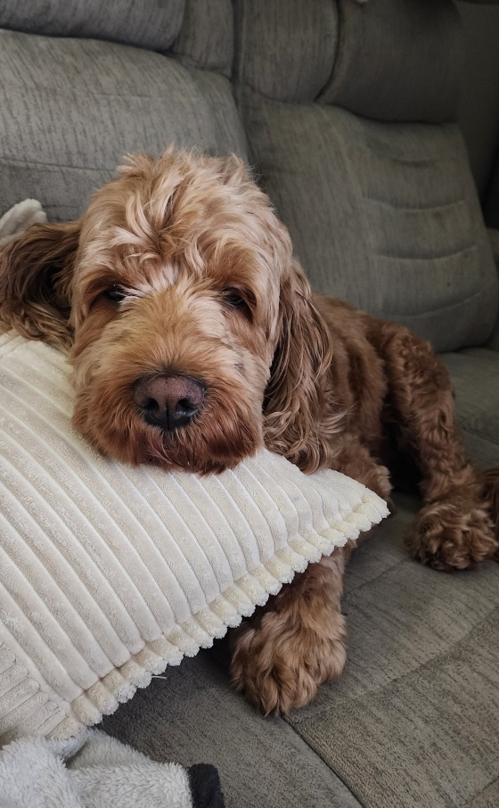
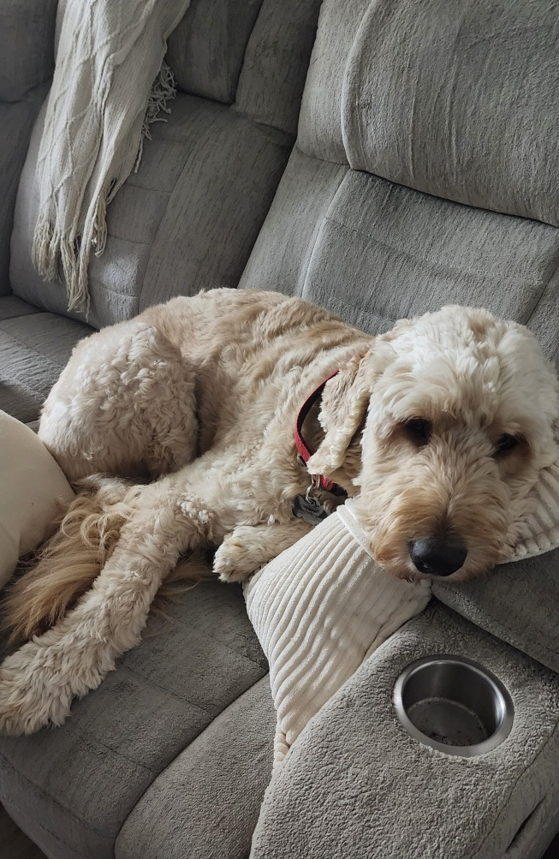
The Driver Behind the Wheel
• Driven by my family and the support
system around me
• Passionate about performance, systems, and continuous improvement
• Hobbies include music, cars, PC gaming

Slide 3
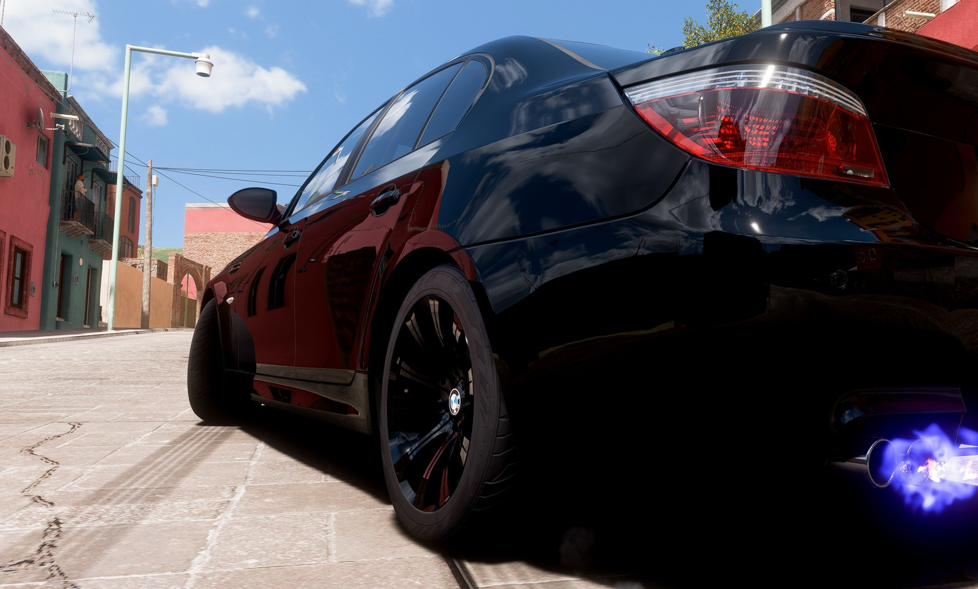
Gaining Traction
• Identified areas where my performance wasn’t gaining the traction needed to move forward effectively
• Communication, time management, and task prioritization are areas of Opportunities for improvement
• Will increase productivity, alignment, and overall quality of my work

Slide 4
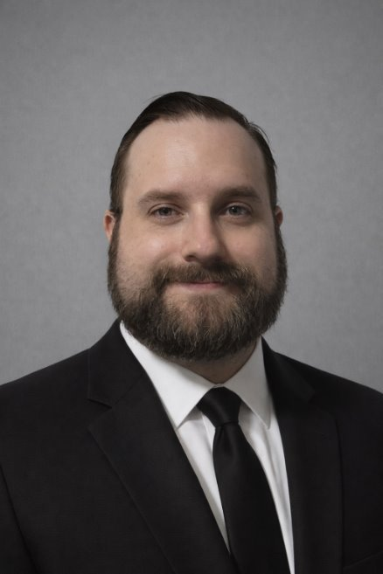
THE DRIVER
Brian Moses • Digital Technology Support Specialist • 4 years at Synchrony • Automotive and Computer Enthusiast • EDM is my favorite music • Interest in Software QA Engineering
" One day, you'll leave this world behind, so live a life you will remember. " - Tim Bergling aka Avicii

Slide 5
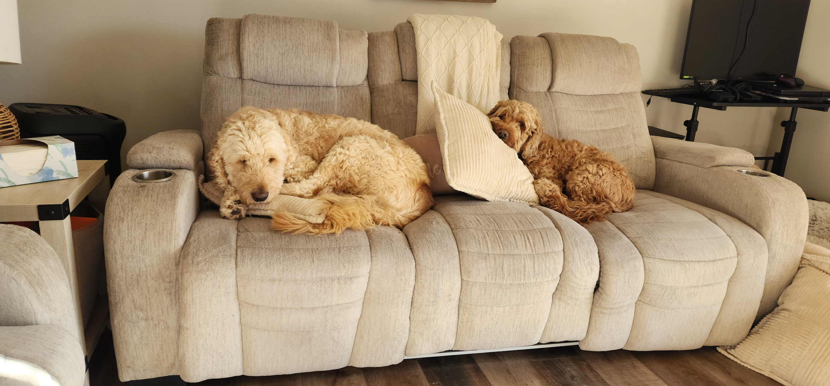
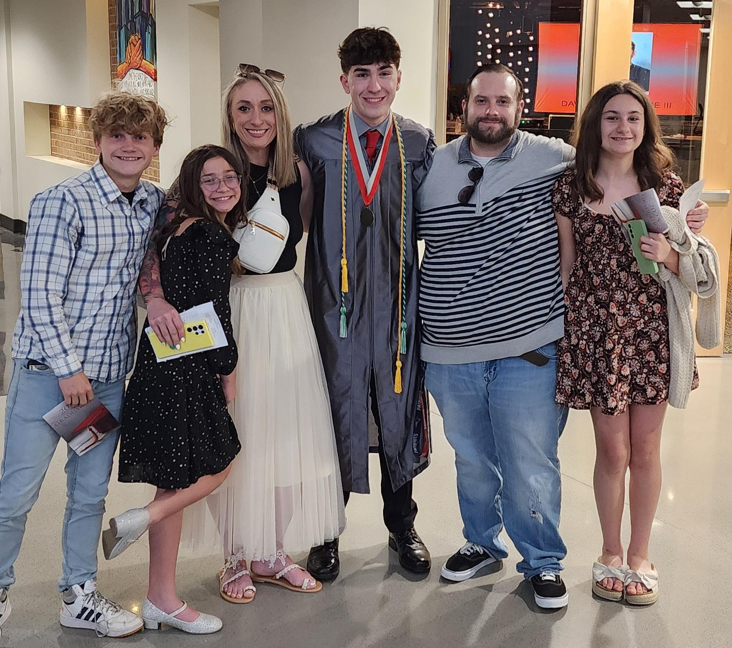
My Family • My wife, 5 children, 2 dogs • Children are 19, 18, 15, 14, and 12 • Goldendoodle, 4, and Cockapoo, 5
THE PASSENGERS

Slide 6
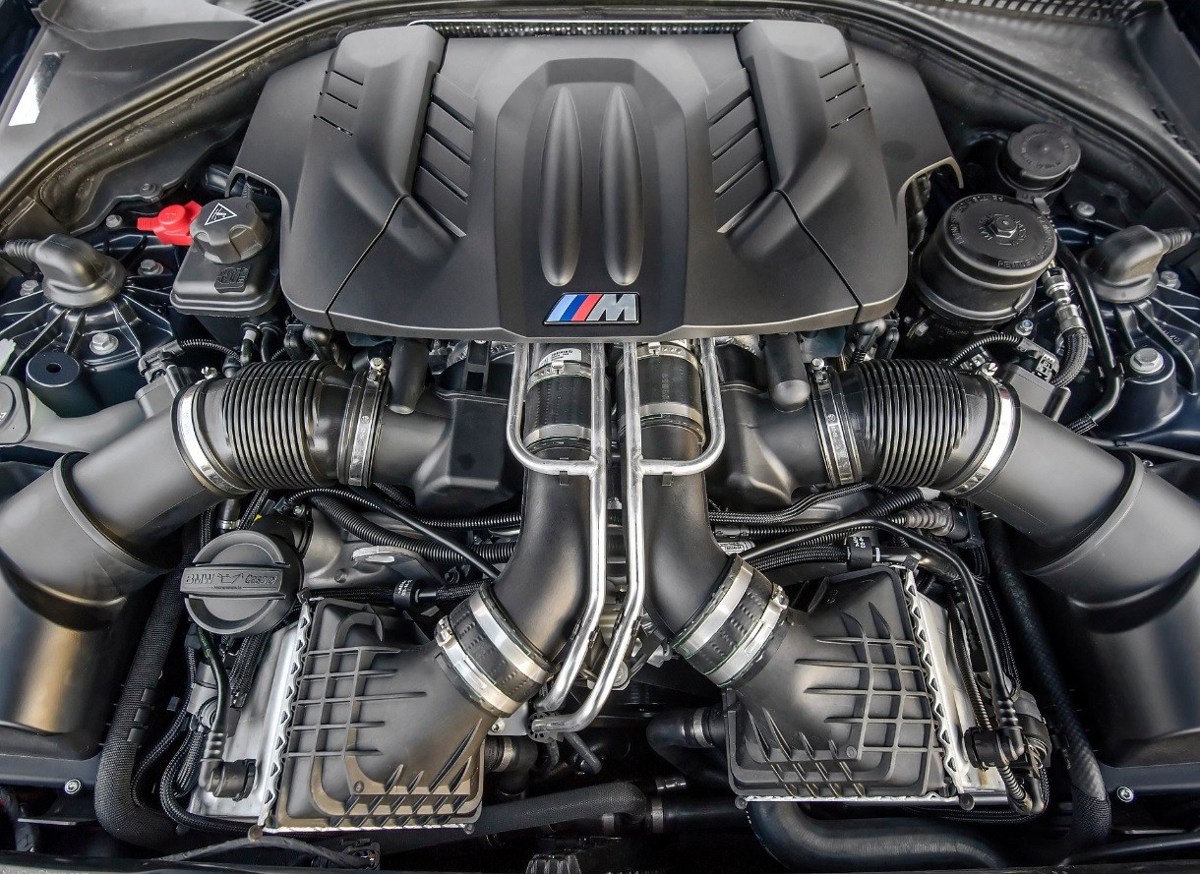
THE ENGINE
Skills Overview • Technical Troubleshooting & Root Cause Analysis • Networking and Systems Knowledge • User Centric Thinking & Communications • General Knowledge of CompTIA N10-009 Network+ Background • Former ASE Certified/GM Certified Maintenance Tech • High priority/Medical Courier • Caterpillar Logistics Leadership Development Team
ERG Networks • EN+ • BE+ • VN+ • APEN+

Slide 7
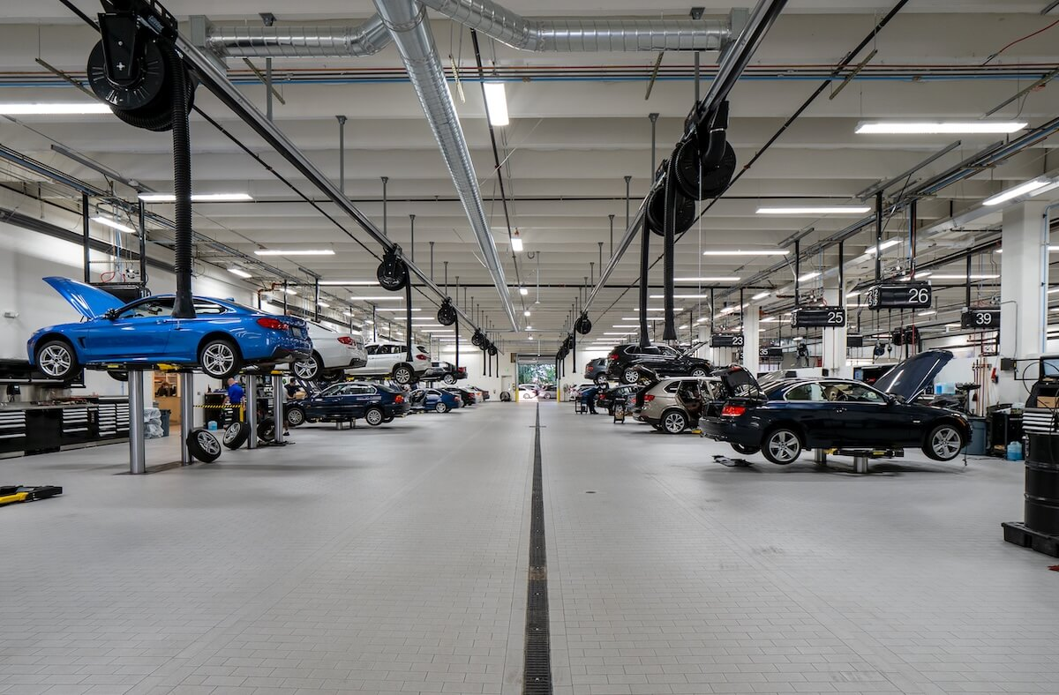
THE ROUTINE MAINTENANCE
Meet the Technicians • Heath Starcher, DTECH Support Operations Manager • Noah Banks, Senior Analyst, Production Support • Ernest Reed, VP Performance and Availability Assurance • Chelsey Vawter, Senior Specialist, Fraud Mitigation REW • Eric Montalvo, AVP DTECH Support Manager

Slide 8
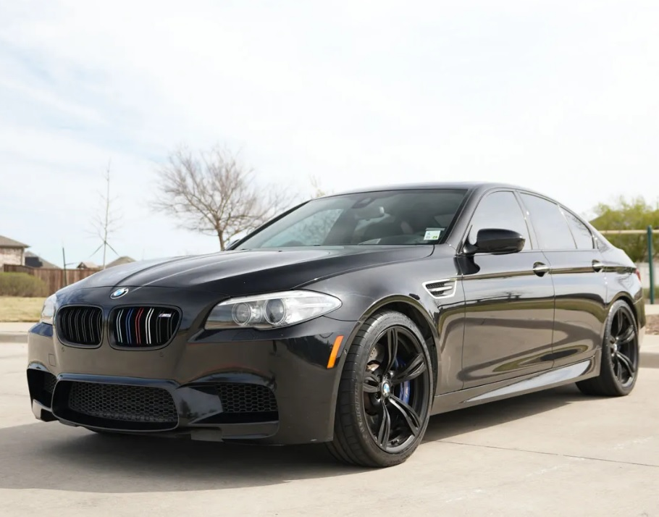
THE ROAD
Roles at Synchrony • Customer Service Representative, Sam's Club • Senior Representative, Digital Technology Support • E.M.O.B. Pilot Team Professional Development • Fall 2025 GEAR • BE+ 2025 GIFTED • CWC Toastmasters 2025 Speechcraft
" A jack of all trades is a master of none, but oftentimes better than a master of one. "

Slide 9
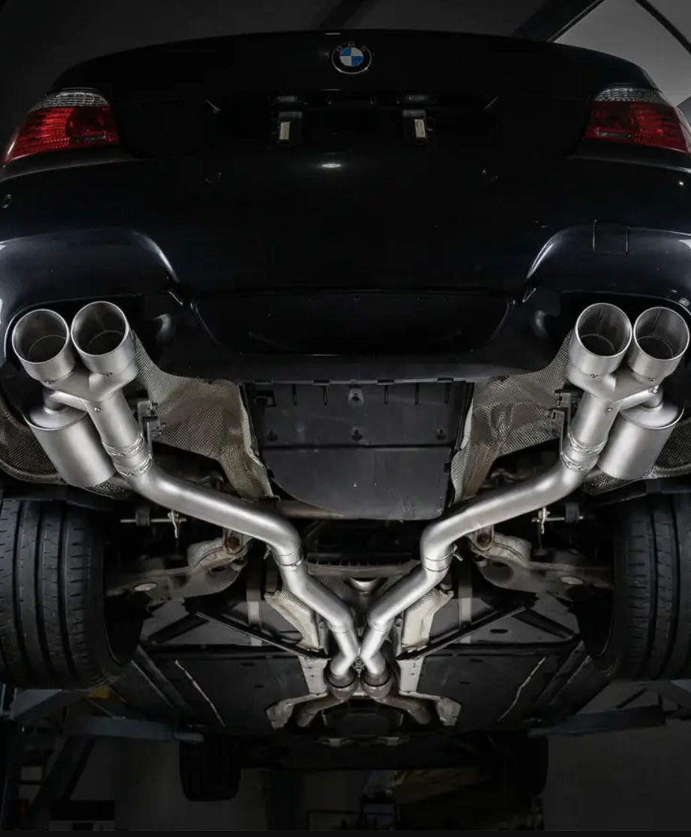
THE WORKSHOP
Current Developments/Activities • CWC STEP 2026 Participant • STEP Video Project Presentation • Leadership Skills through SDLE • Team building skills with CWC STEP 2026 Cohort • Development By Doing Seminar Presentations • Mentoring a co-worker for their own development • Always Networking and Engaging • User Acceptance Testing Global Project • Presentation/Speaking Skills with Toastmasters

Slide 10
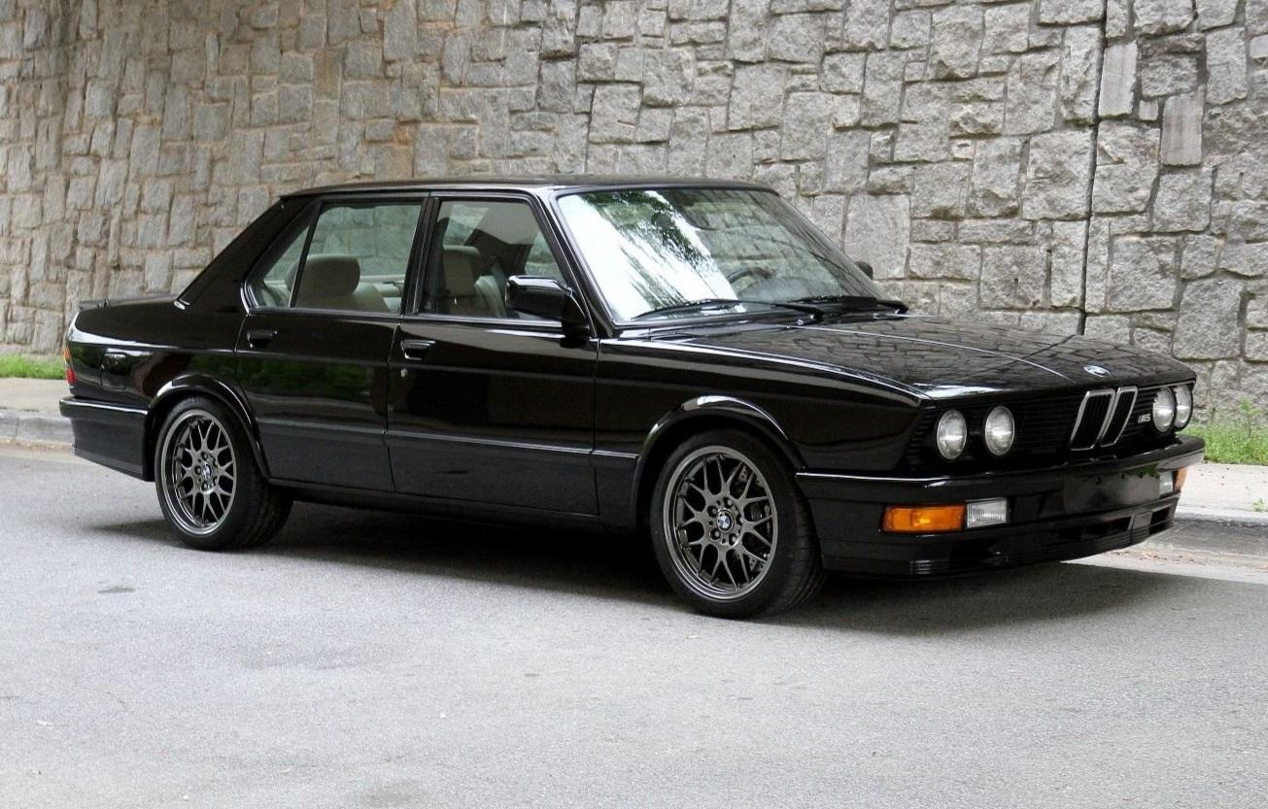
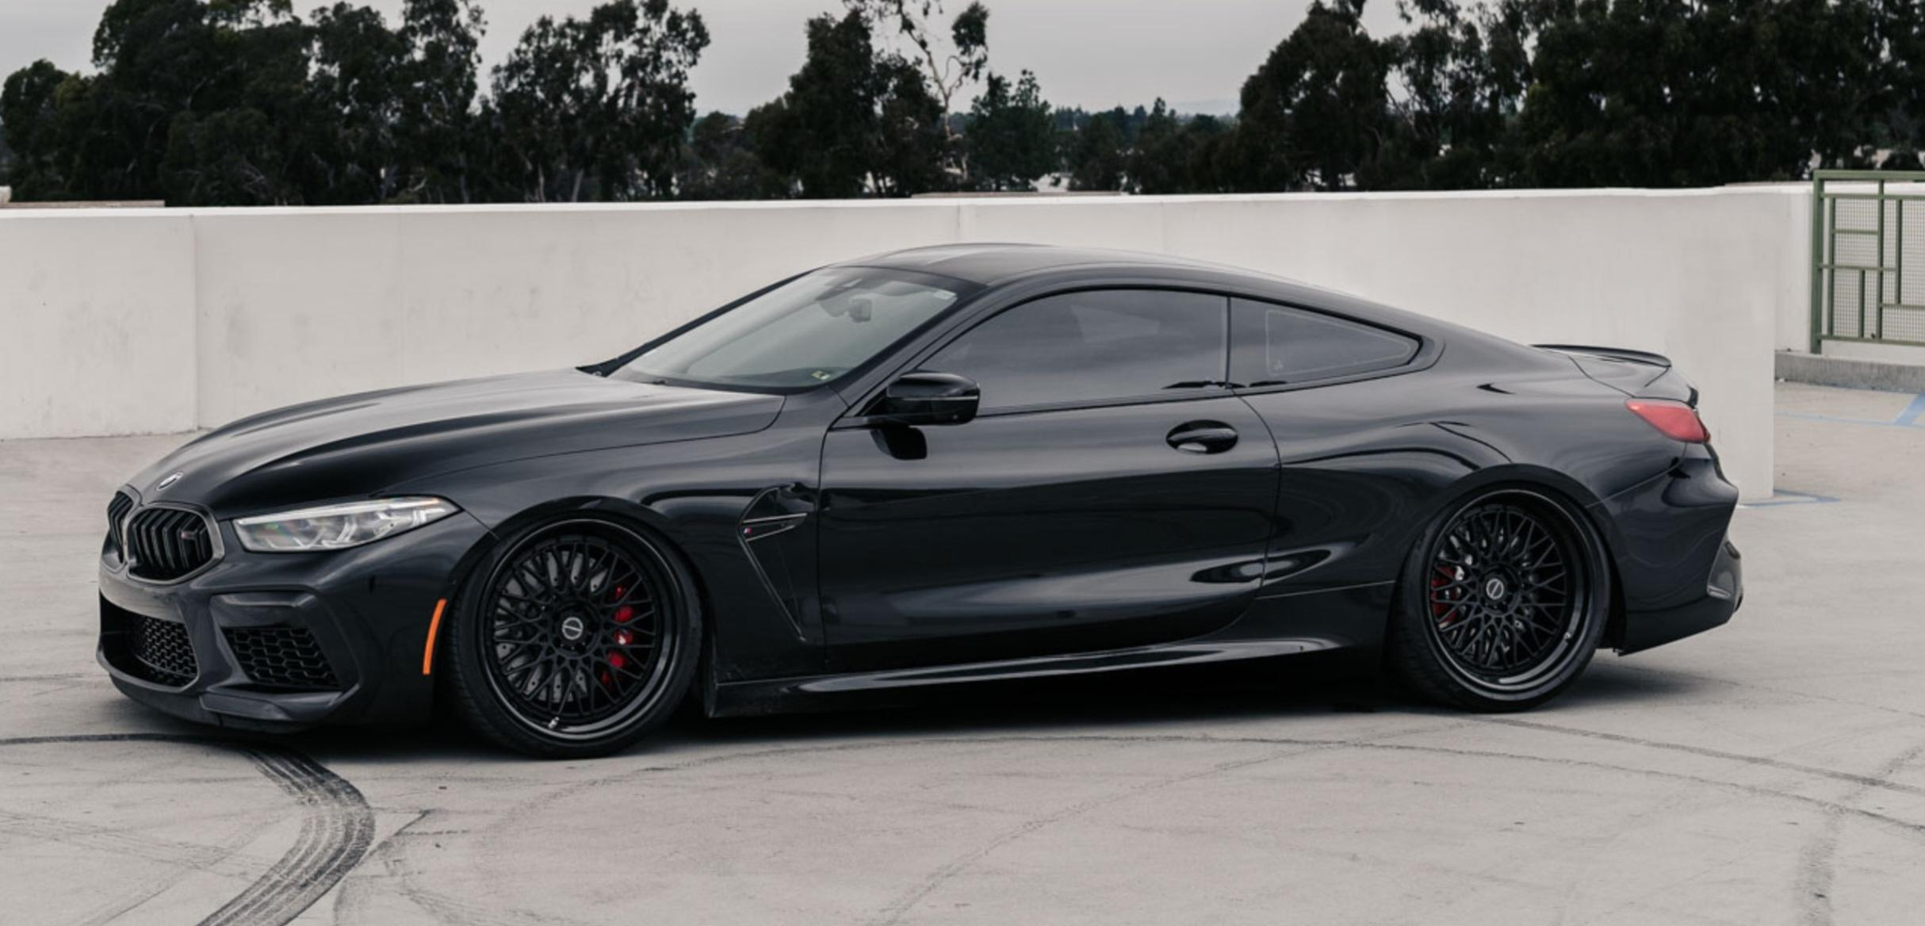
THE DESTINATION
Cincinnati West Chester, Ohio • STEP Level I, II, III
Stamford, Connecticut • STEP Level IV
Edit
" If I can live through this next six months, day by day. What comes next will be marvelous. " - Marea Stamper, Marea (We've lost dancing) by Fred Again..

